Slide 1


ENERGIZE
PROTECTING OUR BELOVED BIKES
IADE – MSc in Creative Computing and Artificial Intelligence (M-CCIA)
In collaboration with Cicla
A solar-powered, intelligent bicycle parking system promoting sustainable urban mobility.

Slide 2
Page 02
TEAM
  Angela Xavier- no.20251484 — AI, Machine Learning, Visualization, IoT, Hardware Integration
  Muhammad Zidane- no.20200057 — IoT, Hardware Integration, AI, Machine Learning, Visualization
A solar-powered, intelligent bicycle parking system promoting sustainable urban mobility.
Project I — MSc in Creative Computing and Artificial Intelligence (M-CCIA)

Slide 3
Page 03
PROBLEM & GOAL
  Problem:
Urban areas experience high rates of bicycle theft and vandalism, discouraging sustainable commuting.
  Goal:
Design a secure, eco-friendly bike storage solution powered by solar energy, enhanced with smart access control and real-time monitoring.
Project I — MSc in Creative Computing and Artificial Intelligence (M-CCIA)

Slide 4
Page 04
CONCEPT: WHAT IS ENERGIZE?
Energize is a modular, solar-powered bike parking system that offers the following features:
  Prevents theft and vandalism.
  Utilizes RFID technology for authorized user access.
  Operates independently on solar power.
  Collects and visualizes usage data via a digital dashboard.
📍 This system is deployable in any urban or campus setting.
Project I — MSc in Creative Computing and Artificial Intelligence (M-CCIA)

Slide 5
Page 05
WHY ENERGIZE?
Smart Access: RFID-based controlled entry.
Solar Integration: Clean, renewable energy powering all functions.
Sensors & Detection: Detects unauthorized access, motion, or tampering.
Sustainability: Fully off-grid operation with minimal maintenance.
Project I — MSc in Creative Computing and Artificial Intelligence (M-CCIA)

Slide 6
Page 06
IOT ARCHITECTURE
System Overview::
  Sensors → Microcontroller (ESP32) → Wi-Fi → Database → Visualization Interface
“Sensor data (motion, vibration, energy) is processed by the ESP32 and sent to the database for live monitoring.”
Project I — MSc in Creative Computing and Artificial Intelligence (M-CCIA)

Slide 7
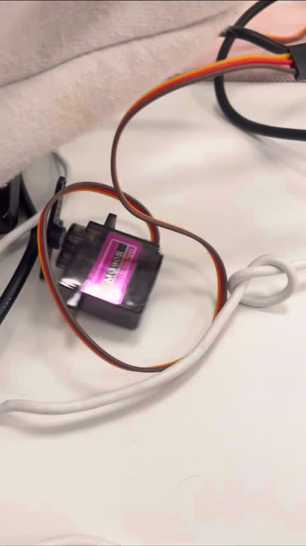
Page 07
IOT ARCHITECTURE
Components::
  Sensors: Motion, proximity, vibration, energy.
  Controller: ESP32 (data acquisition and transmission).
  Dashboard: Displays system activity and energy usage.
  Power Source: Photovoltaic panels with smart charging.
Real-time monitoring of bikes, solar performance, and occupancy.
Project I — MSc in Creative Computing and Artificial Intelligence (M-CCIA)

Slide 8
Page 08
AI & MACHINE LEARNING INTEGRATION
AI Goals:
  Theft detection through anomaly recognition.
  Predicting usage patterns / occupancy forecasting.
  Energy optimization based on solar and usage data.
Data Inputs:
  Sensor readings (motion, proximity, solar).
  RFID logs and user access data.
  Environmental conditions (light, temperature).
Expected Outputs:
  Alerts, predictive usage trends, energy efficiency adjustments.
Project I — MSc in Creative Computing and Artificial Intelligence (M-CCIA)

Slide 9


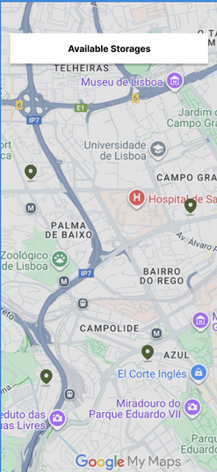
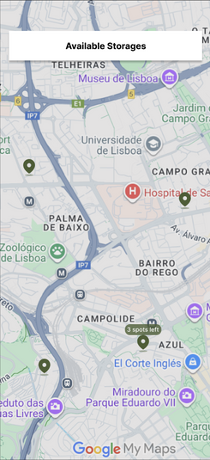
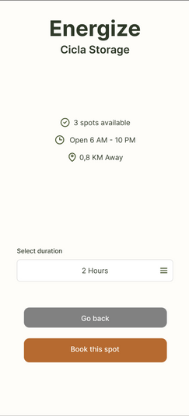
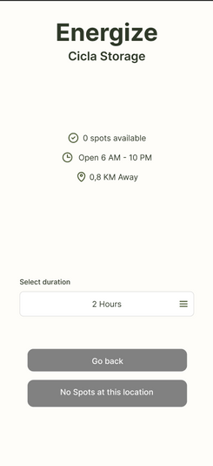
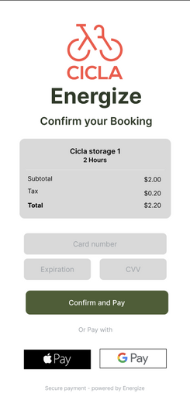

Page 09
APP DEMO SLIDES
https://www.figma.com/proto/fpUW6Ks5iYP9N9WOYbjs0B/energize-app?node-id=14-11&p=f&t=GVqSuSpwrfGSQXgR-0&scaling=scale-down&content-scaling=fixed&page-id=0%3A1&starting-point-node-id=14%3A4
Project I — MSc in Creative Computing and Artificial Intelligence (M-CCIA)

Slide 10
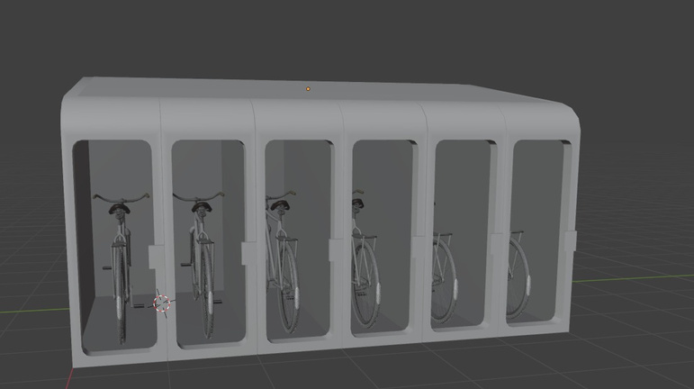
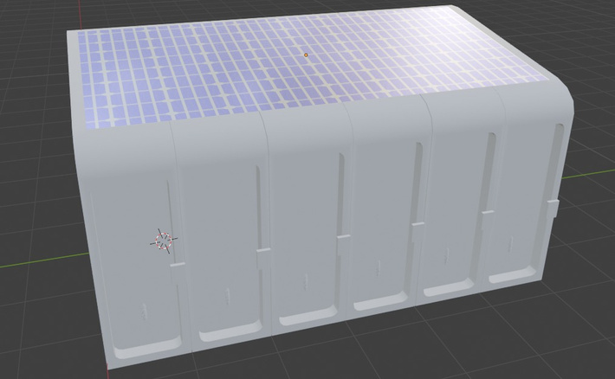
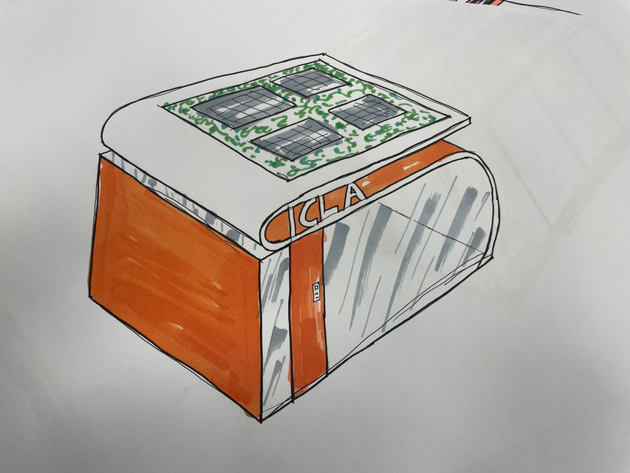
Page 10
PROTOTYPE / RENDERS
Project I — MSc in Creative Computing and Artificial Intelligence (M-CCIA)

Slide 11
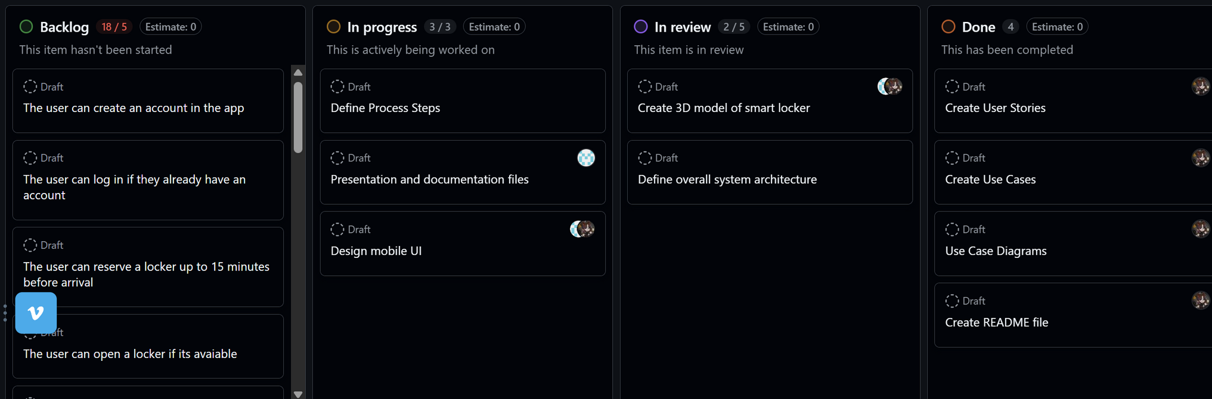
Page 11
PROJECT ROLES & TIMELINE
https://github.com/users/Akawii/projects/2/views/1
Project I — MSc in Creative Computing and Artificial Intelligence (M-CCIA)

Slide 12
Page 12
NEXT STEPS
Build the IoT prototype (ESP32 + sensors).
Develop basic ML models using simulated data.
Create interface mockups (P5.js & Unity).
Prepare documentation and promotional media for Milestone 2.
Collect test data for AI training.
Project I — MSc in Creative Computing and Artificial Intelligence (M-CCIA)

Slide 13
THANK YOU
Energize — Protecting our beloved bikes
Smart, sustainable, and secure urban mobility for a cleaner future

